Slide 1
Cancer leads to malnutrition or Malnutrition leads to Cancer !!
Prof.A.fattah A. Sattar
Anesthesia & pain Relief Department
National Cancer Institute
Cairo University
2018

Slide 2
Malnutrition
Malnutrition is a state of nutrition in which
a( deficiency) or
( excess) or
(imbalance) of energy, protein, and other nutrients causes measurable adverse effects on
tissue/body form (body shape, size and composition)
and function,
and clinical outcome.

Slide 3
Nutritional status of patients with cancer: frequency and severity of weight loss

Slide 4
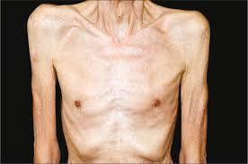
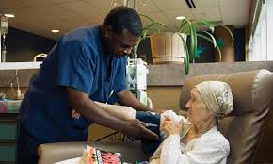
Cancer Cachexia

Slide 6
anorexia and/or other symptoms alone
do not explain body-composition changes
of cachexia
and
cachexia can occur in the absence of
anorexia
yet …

Slide 7
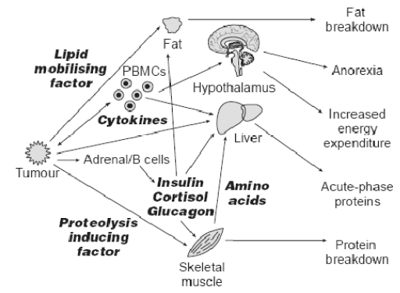
Van Cutsem E & Arends J. Eur J Oncol Nurs 2005

Slide 8
Does Conventional Nutritional Support Improve the Outcome of cancer ????

Slide 9
Nutritional support
cures malnutrition, not cancer
Brennan; N. Engl. J. Med. 305;375. 1981

Slide 10
Weight loss and quality of life in patients with GI malignancy

Slide 11
Instead of nutritional support alone, the development and implementation of combination strategies incorporating nutritional support should be implemented.

Slide 12
Pharmacological and Multimodal Therapy for Cancer Cachexia
. Pharmacological treatment of cachexia
1 Appetite stimulants
2 Agents which attenuate skeletal muscle catabolism
3 Agents which promote skeletal muscle anabolism
Multimodal therapy for cachexia
1 Nutritional support
2 Exercise regimen
3 Supportive care

Slide 13
Diet and cancer
Does different foods and their constituents modify cancer risk and tumour behaviour???

Slide 14
In 1997 the WCRF*/#AICR report *World Cancer Research Fund # American Institute for Cancer Research
cancer is principally caused by environmental factors, of which the most important are tobacco, diet and factors related to diet, including body mass and physical activity, and exposures in the workplace and elsewhere."
The same report concluded that 30 to 40 percent of all cancers are directly linked to dietary choices.
Diet, physical activity and maintenance of a healthy weight can prevent 40% of all cancers.

Slide 15
Diet and cancer
Cancer is a preventable disease‼
Food, Nutrition, Physical activity and the Prevention of Cancer

Slide 16
Cancer is a preventable disease ‼
While inherited gene mutation is responsible only for 5-10% of all cancer cases, inhered variants of gene encoding, enzymes involved in activation of detoxification of exogenous carcinogenic factors, and repair of subtle mistakes in DNA structure are much more frequent.
Genetics and environment works in concert.

Slide 17
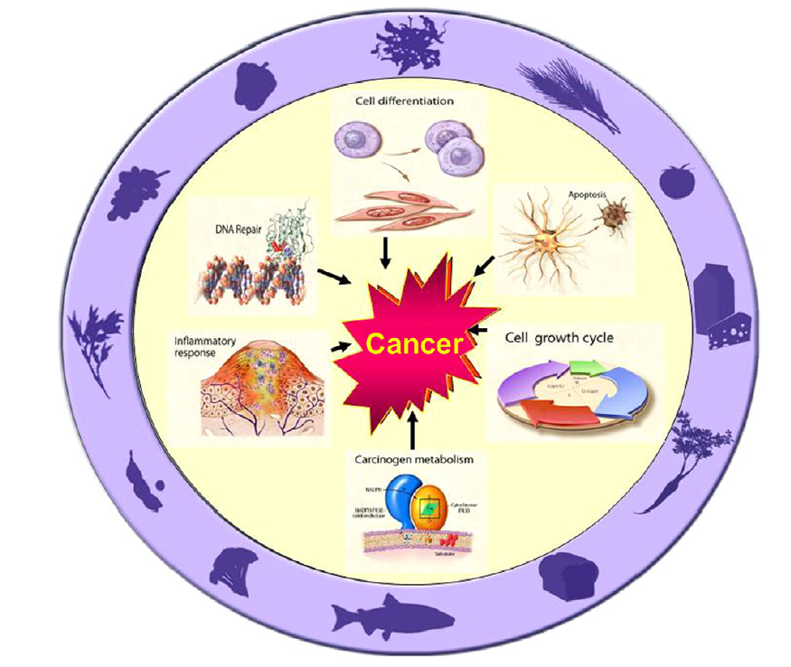
From: Milner JA. Nutrition and cancer: Essential elements for a roadmap.
Cancer Letters 269 (2008) 189–198

Slide 18
Evidence from ecological studies
Studies on migrant population have provided some of the most compelling evidence, suggesting not only that the main causes of cancer are environmental , but that food, nutrition and maintenance of a healthy weight play a major role.

Slide 19
Examples
Foreign born Hispanics moved to San Francisco Bay area, breast cancer risk was 50% lower than U.S. born Hispanics.
The risk increased with increasing residence in U.S.and with decreasing age at migration.
Similarly, stomach cancer mortality in migrants from Former Soviet Union (FSU), a high-risk area, to Germany remained elevated after migration but started to decline during a study period ranging from 1990 to 2005 in Germany.
in second-generation immigrants, cancer incidence rates generally become similar to those of the host country.

Slide 20
In 2007 review of the updated literature resulted in the publication of a second WCRF/AICR document entitled Food, Nutrition, Physical activity, and the Prevention of cancer: a Global Perspective

Slide 21
Does what we eat and drink affect our risk of developing cancer????

Slide 22
Food contaminants and food additives
Thousands of chemical substances, some of them with carcinogenic properties, contaminate the food supply.
They include chemicals added to modify flavour, colour, stability or texture, pesticides residues and drugs given to animals.
In addition, chemical contaminants may be formed during food preparation or find their way into foods during industrial processing and packaging.

Slide 23
Food contaminants and food additives
Food can also be contaminated by naturally occurring carcinogens such as mycotoxins from mold growth, and aflatoxin is a definite cause of liver cancer risk.
Aflatoxins are a type of mycotoxins classified as human carcinogens (group 1) by the AIRC.
Contamination involves mainly cereals and legumes (especially peanuts), followed by nuts and seeds, and is more frequent in countries with damp climates and poor storage conditions.

Slide 24
Food contaminants and food additives
Aflatoxins are converted to their carcinogenic forms through metabolism by members of the cytochrome P-450 enzyme superfamily to intermediates, which act as carcinogens through covalent interaction with cellular DNA and proteins.
the glutathione S-transferase (GST) family of metabolising enzymes are a factor in individual susceptibility to aflatoxin-induced hepatocarcinogenesis.

Slide 25
Food contaminants and food additives
Among all substances, acrylamide recently gained momentum as a potential public health concern. Acrylamide is a proven rodent carcinogen and probable human carcinogen.
chemical analysis demonstrated substantial levels of acrylamide in various heat-treated carbohydrate-rich foods.
Biochemical analysis showed that during food processing at temperatures above 120C, free asparagine and sugars react together with formation of acrylamide.

Slide 26
Food contaminants and food additives
Potato chips, french fries, certain brands of cookies and breakfast cereals contain very high levels of acrylamide.
especially considering that children, a particularly vulnerable population, tend to have high estimated daily intakes, 2-3 greater than those of adults.
Epidemiological studies, conducted so, far generally do not support a role for dietary acrylamide as a risk factor for developing cancer.

Slide 27
Major findings of the report are
Red meat and processed meat (meat preserved by smoking, curing, salting, or by the addition of preservatives) is a cause of colorectal cancer.
Cooking meat at high temperatures (i.e., frying, grilling, and barbecuing) induces heterocyclic amines formation, and broiling and charbroiling meat or fish over direct flame leads to the production of polycyclic aromatic hydrocarbons.

Slide 28
Processed meat may also contain nitrates and nitrites. Nitrate (NO3) is an inorganic compound that occurs under a variety of conditions in the environment .
Nitrates are essentially non-toxic but can be reduced to nitrites (NO2) either in improperly stored food, or in the body.
The nitrites from these and other sources present a toxic hazard both by their direct toxicity and by formation of carcinogenic N-nitroso compounds (nitrosamines) ; they are recognized carcinogens.

Slide 29
In any case, most epidemiological data linking red meat to colon cancer risk relate to the way meat is cooked and preserved, rather than to meat itself.
Milk and more significantly dietary calcium (from dairy, vegetables, nuts, pulses and fish or meat cooked on the bone) protects from colorectal cancer.
High dietary intake of calcium is a probable cause of prostate cancer. The evidence is consistent with a dose-response relationship;.

Slide 31
Protective dietary components
Foods contain a wide range of compounds with documented chemopreventive activity, some of which are known as phytochemicals.
Phytochemicals are chemical compounds produced by plants to them thrive, confer particular properties on foods, such as taste and colour, and possess in various degrees anti-oxidant, anti-carcinogenic, anti-inflammatory, immunomodulant and antimicrobial effects.
According to their chemical structure and functional characteristics they are grouped in different families, which include:

Slide 32
Carotenoids pro-vitamin A alpha-carotene. carrots, apricot, peaches, cantaloupe, sweet potatoes, winter squash, kale, spinach, romaine lettuce and broccoli
Flavonoids
Isothiocyanates
polyphenolic compounds ubiquitously found in plants and responsible for their pigmentation.
flavonols,, flavones, isoflavones, flavanones, catechins, anthocyanins, and anthocyanidins.
cruciferous vegetables such as broccoli, cauliflower, kale, turnips, collards, Brussels sprouts, cabbage, radish, turnip and watercress

Slide 33
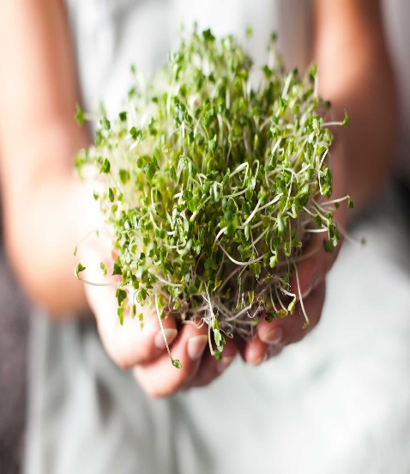
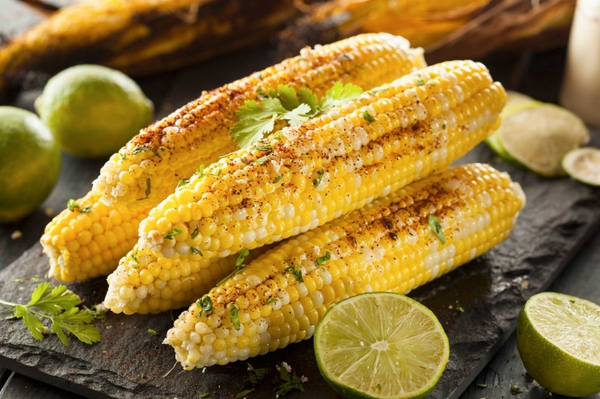
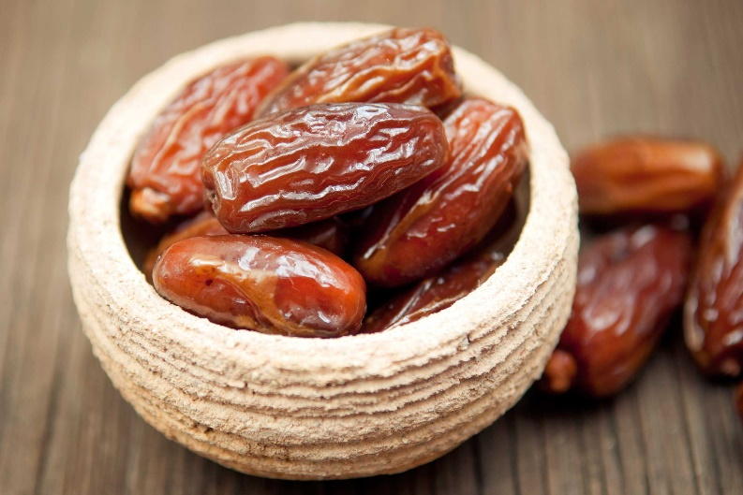
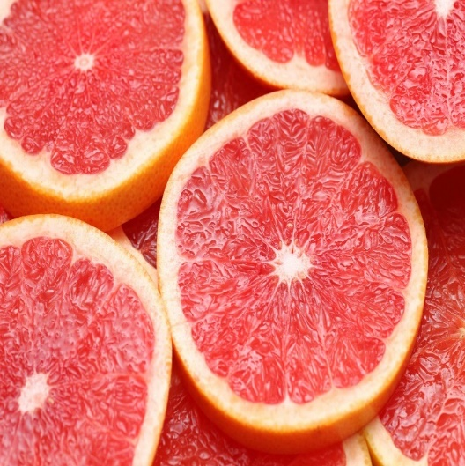
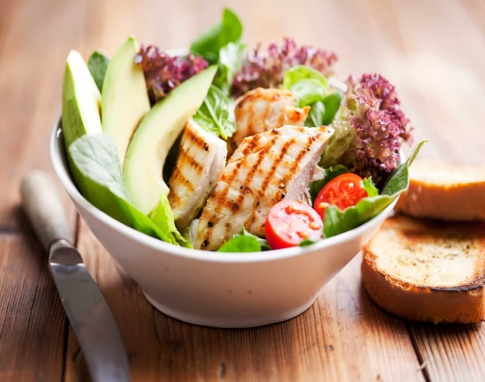
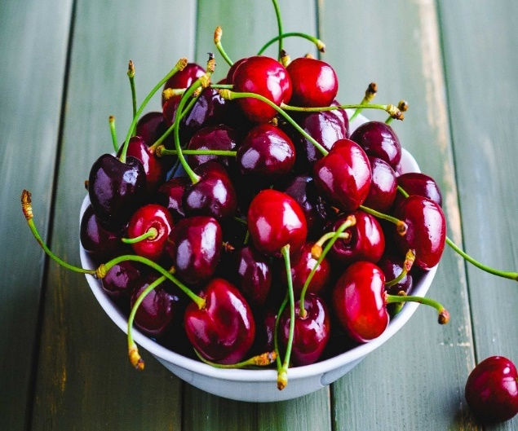
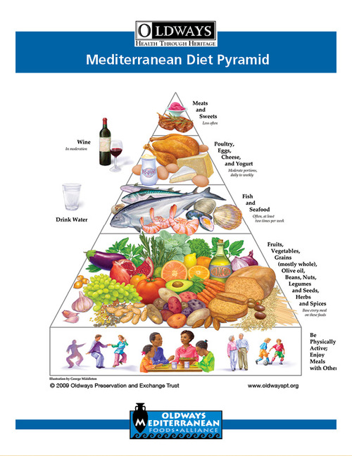
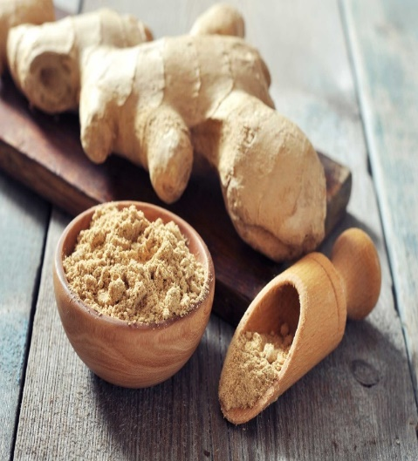
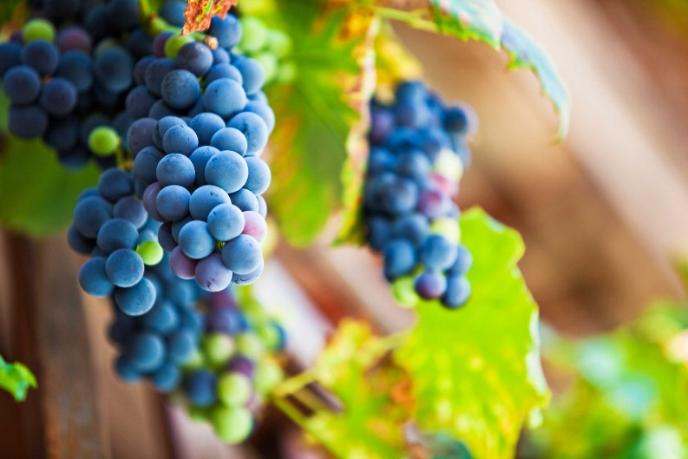
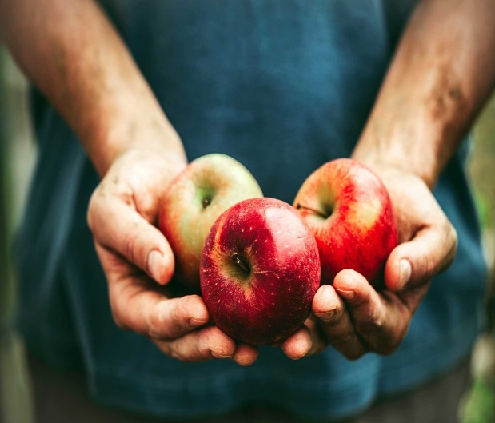

Slide 36
Vitamin D
Previtamin D3 ↔ VitaminD3 ↔ Liver ↔25(OH)D 3↔ Kidney prostate,breast,colon ↓ ↓ ↓ ↓
Skin,salmon, milk,eggs
1,25(OH)2D3 1,25(OH)2D3
↓ ↓
1- Regulation of cell growth 2- regulation of immune system 3- calcium,bone,muscle
Cancer prevention autoimmune disease prevention heart disease and
diabetes prevention
Because 1,25(OH)2D3 is extremely potent in inhibiting cancer cell growth, this all seemed to make sense.

Slide 37
Vitamin D
A variety of factors, including serum phosphorus (Pi) and parathyroid hormone (PTH), regulate the renal production of 1,25(OH)2D. 1,25(OH)2D regulates calcium metabolism through its interaction with its major target tissues, the bone, and the intestine.
Indeed, neither increased exposure to sunlight nor increased oral intake of vitamin raised blood concentrations of 1,25(OH)2D3.
The WCRF review concluded that there is no evidence that vitamin supplements help prevent cancer,

Slide 38
Vitamin D.(contin.)
Evidence-based vitamin D recommended intake
IOM* values for Adequate Intake has been defined as 200 IU/day for ages infant to 50, 400 IU/day for 51-70, 600 IU/day over 70. and, in the absence of exposure to sunlight, a minimum of 1000 IU vitamin D/d is required to maintain a healthy concentration of 25(OH)D in the blood. Am J Clin Nutr 2004;79:362–71.
, while a tolerable upper intake level (UL) has been set at 2000 IU/day for adults.
Data from recent trials show that even these levels are insufficient to achieve protection from cancer and many other diseases, and point to an urgent need for revision of current recommendations to reduce global cancer burden worldwide.
*Institute of Medicine

Slide 39
The second expert report recommendations include:
exercising moderately;
limiting consumption of alcohol, energy-dense foods and refined carbohydrates;
avoiding sugary beverages;
increasing intake of vegetables and fruits to at least five portions per day;
maintaining a body mass index of between 21 and 23 (until now, the standard recommended range has been 18.5 to 24.5)

Slide 40
The second expert report recommendations include:
6. increasing intake of whole cereals (mainly in an unprocessed form) and legumes;
7.consuming fast foods sparingly, if at all;
8.limiting intake of salty and sodium-processed foods to less than 5 g of salt or 2 g of sodium per day;
9.limiting consumption of red meats and avoiding processed meats;
10.after treatment, cancer survivors should follow these recommendations for cancer prevention.

Slide 41
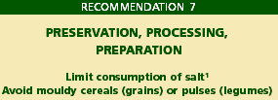
WCRF(World Cancer Research Fund) recommendations
Further
Implementation
With
Normalized
Vitamin D status?
WCRF/AICR. Food, Nutrition, Physical Activity and the Prevention of Cancer: a Global Perspective, AICR, Washington DC 2007

Slide 42
Reference
WCRF, World Cancer Research Fund /AICR, American Institute for Cancer Research. Food, Nutrition, Physical Activity, and the Prevention of Cancer: a Global Perspective. 2007 http://www.dietandcancerreport.org/.

Slide 44
a Healthy Mediterranean-Style Eating Pattern and a Healthy Vegetarian Eating Pattern
the Healthy Mediterranean Style Eating Pattern and the Healthy Vegetarian Eating Pattern. Both of these patterns align with the Guidelines.
the Healthy Vegetarian Eating Pattern includes more legumes (beans and peas), soy products, nuts and seeds, and whole grains. It contains no meats, poultry, or seafood, and is identical to the Healthy U.S
but is somewhat higher in calcium and dietary fiber and lower in vitamin D, due to differences in the foods included in the protein foods group, specifically more tofu and beans and no seafood

Slide 45
Conclusions
Cancer is a preventable disease;
Environmental factors play a prominent role in increasing cancer risk;
Diet, physical activity and maintenance of a healthy weight can prevent 40% of all cancers
Fruit, vegetables, and fibre have a protective effect, whereas high-temperature cooked red meat and processed meat increase the risk of developing cancer.

Slide 46
Conclusions
While there is no evidence that intake of non-physiologic doses of vitamin supplements would prevent an array of conditions attributable to oxidative stress, correction of vitamin D deficiency is seemingly playing a major role in reducing incidence and mortality from a host of chronic conditions, including cancer.

Slide 48
The “war on cancer”
we are facing a global cancer epidemic
Between 1975 and 2000 cancer cases doubled, they will double again between 2000 and 2020 and nearly triple by 2030.(13-17 million deaths will occur from neoplastic diseases)
A GLOBAL PROBLEM
Cancer is increasing in less developed countries

Slide 49
it is imperative to consistently redirect public health policies, government programs and research funding from cancer treatment and early diagnosis to primary cancer prevention if we want to significantly reduce these growing trends.

Slide 50
